Slide 1
M12 - JavaScript

Slide 2
Brief Background
Designed by Brendan Eich
Developed by:
Netscape Communications Corporation
Mozilla Foundation
Ecma International

Slide 3

Notes:
* It was named JavaScript to attract Java Developers.

Slide 4
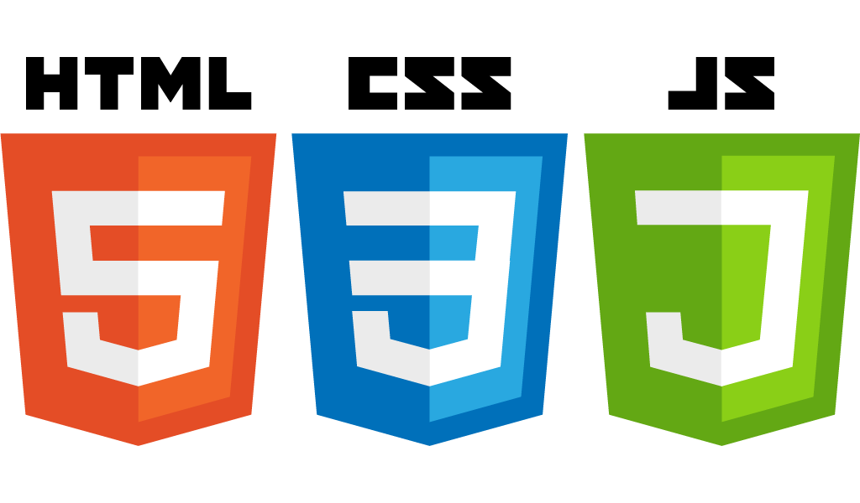
JavaScript is one of the 3 languages all web developers must learn
HTML to define the content of web pages
CSS to specify the layout of web pages
JavaScript to program the behavior of web pages

Slide 5
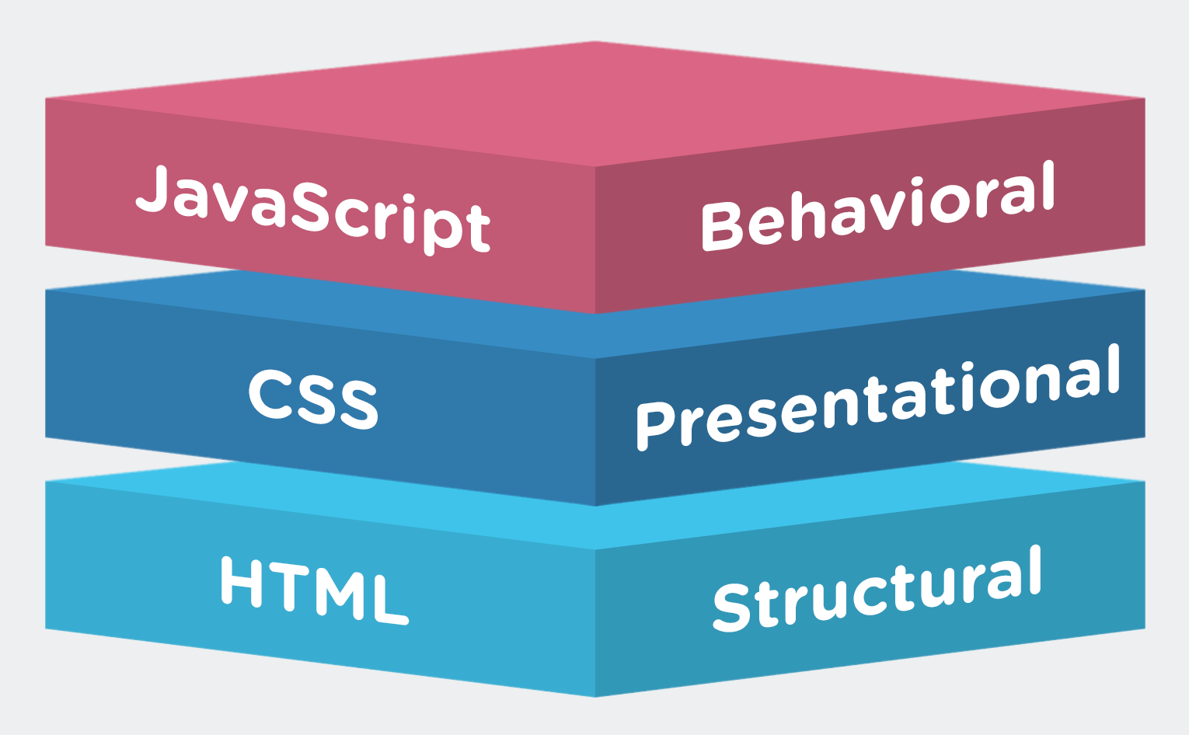

Slide 6
Introduction
“programming language” of HTML and the Web
commonly used as part of web browsers
interact with the user
control the browser
runs synchronously
communicate asynchronously
alter the document content that is displayed
Notes:
Commonly used as part of web browsers – but can also run on NodeJS
JS is Synchronous

Slide 7
Using JavaScript in HTML
JavaScript can run on HTML by using the script tag
JavaScript can be written inside a script tag or
Imported to HTML using the attribute src
<script>
var x = 5;
console.log(x);
</script>
<script src="myScript.js"></script>

Slide 8
External JavaScript Advantages
It separates HTML and code
It makes HTML and JavaScript easier to read and maintain
Cached JavaScript files can speed up page loads

Slide 9
JavaScript Output
Writing into an alert box, using window.alert()
Writing into the HTML
using document.write()
using innerHTML
Writing into the browser console, using console.log()

Slide 10
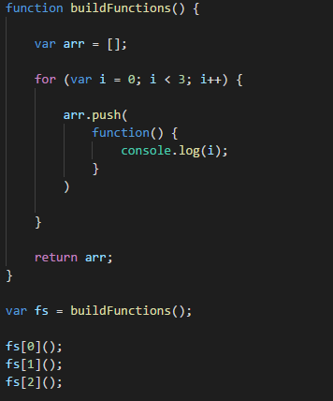
BONUS:
Notes:
Answer:
3
3
3

Slide 11
Writing a JavaScript Code

Slide 12
Writing JavaScript
JavaScript uses the var keyword to define variables.
An equal sign is used to assign values to variables.
var x;
x = 6;
var y, z = 4;
JavaScript statements are separated by ;
Code after double slashes // or between /* and */are treated as a comments.
Notes:
Semicolons are “optional” JS automatically inserts ;
- this may cause errors so always put ; where they are supposed to be
function getPerson(){
return
{
name:’Person’
}
}
Console.log(getPerson());

Slide 13
JavaScript is Case Sensitive
All JavaScript identifiers are case sensitive.
The variables lastName and lastname, are two different variables.

Slide 14
Control Statements

Slide 15
Control Statements
if
else
else … if
switch
can be a mixture of string and numbers
break
default
Notes:
var text;
switch ('test') {
case 'test':
case 5:
text = “text 1";
break;
case 0:
case 6:
text = “Text 2";
break;
default:
text = “Default";
}

Slide 16
Loops
Executing a block of code a number of times.

Slide 17
For Loop
text += cars[0] + "<br>"; text += cars[1] + "<br>"; text += cars[2] + "<br>"; text += cars[3] + "<br>"; text += cars[4] + "<br>"; text += cars[5] + "<br>";
for (i = 0; i < cars.length; i++) { text += cars[i] + "<br>"; }

Slide 18
For/In Loop
loops through the properties of an object
var person = {
firstName: "John",
lastName: "Doe",
age:25
}; var text = ""; for (property in person) { text += person[property]; }

Slide 19
For/Of Loop
Used to loop through an array
var numbers= [1,2,3] for (number of numbers) { console.log(number); }

Slide 20
While Loop
Runs a block of code as long as the specified condition is true
while (condition) { code block to be executed }

Slide 21
Do/While Loop
Executes the block of code at least once
do { code block to be executed } while (condition);

Slide 22
Execution Contexts and Lexical Environments

Slide 23
Execution Contexts and Lexical Environments
Syntax Parsers
reads your code, determines what it does
Check if its grammar is valid
Execution Contexts
wrapper that manages the code currently running
and which lexical environment is running
Lexical Environments
where it is written
what surrounds it
Notes:
JavaScript: Understanding the Weird Parts
Section 2: Lecture 6

Slide 24
Global Environment and Global Object
On load, JS creates a Global Execution Context (Base Execution Context)
global object
can be called using the keyword this
Outer Environment
Code
Global
“Not Inside a Function”
Notes:
TODO: draw picture, create blank js file then run
Global Context > Global Object >this > Outer Environment > Code
Creates Global Object and special variable called ‘this’

Slide 25
Execution Contexts
Creation Phase
Hoisting - Setting up memory space for variables and functions
Functions and its entirety are saved into memory
Variables are saved and its value is set to undefined as a placeholder
Execution Phase
Runs the code line by line
Notes:
Section 2: Lecture 10
Creation Phase reads all var and function
Execution Phase – line by line

Slide 26
Undefined
Special value in JavaScript
Indicates that a variable has been saved to memory but no value has been assigned yet
Notes:
Section 2: Lecture 10
Not defined vs. Undefined

Slide 27
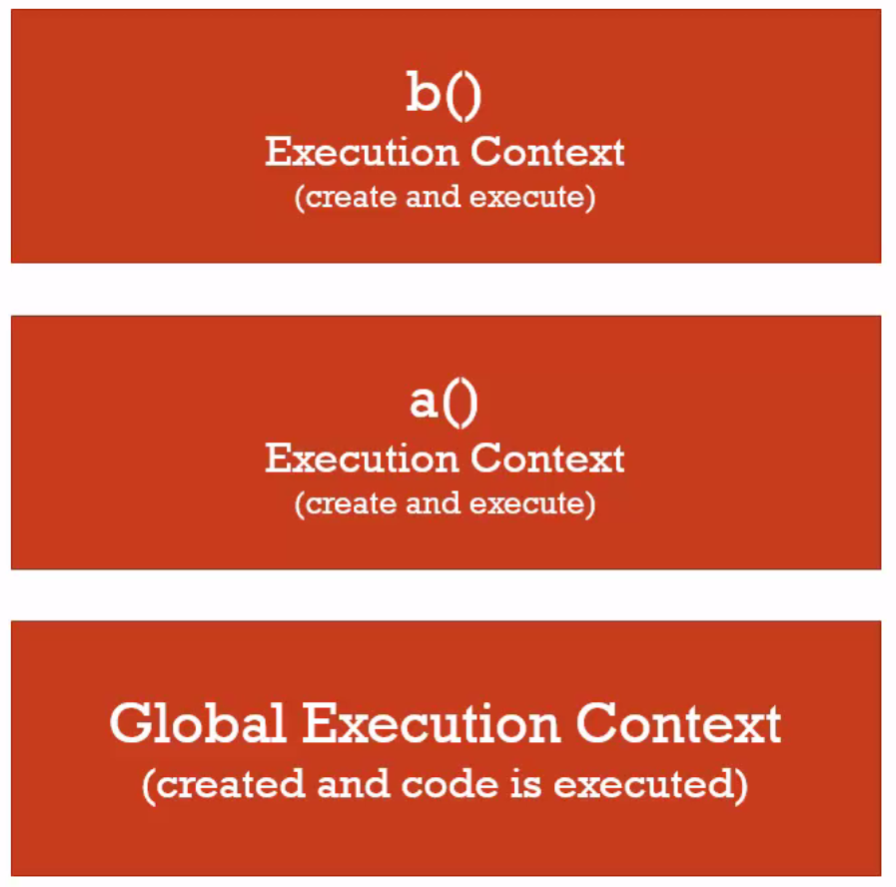
Function Invocation and the Execution Stack
Invocation – running a function using ()
Execution Stack
function b(){
} function a(){
b();
} a();
Notes:
Section 2: Lecture 14 & 15
Function is an object
Question:
function b(){
console.log(myVar)
} function a(){
var myVar = 2;
b();
}
var myVar = 1; a();
What is the result?

Slide 28
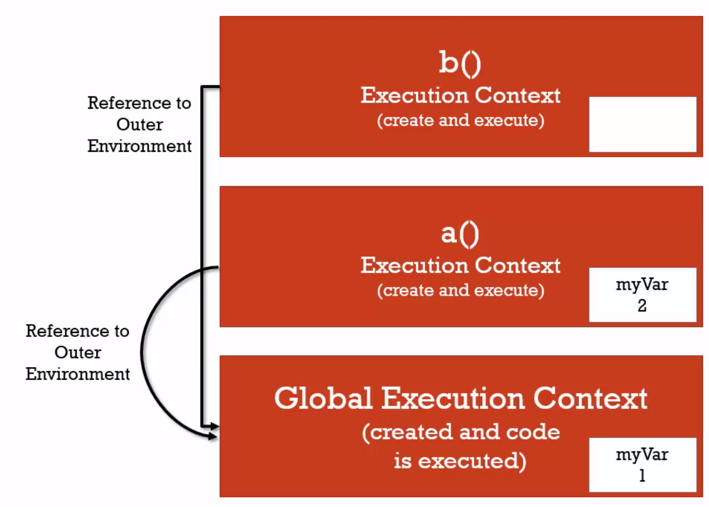
Scope Chain
function b(){
console.log(myVar)
} function a(){
var myVar = 2;
b();
}
var myVar = 1; a();
Notes:
Section 2: Lecture 14 & 15
Reference to outer (Lexical) environment
Question: What will be the output for the code below?
function a(){
function b(){
console.log(myVar)
}
var myVar = 2;
b();
}
var myVar = 1; a();

Slide 29
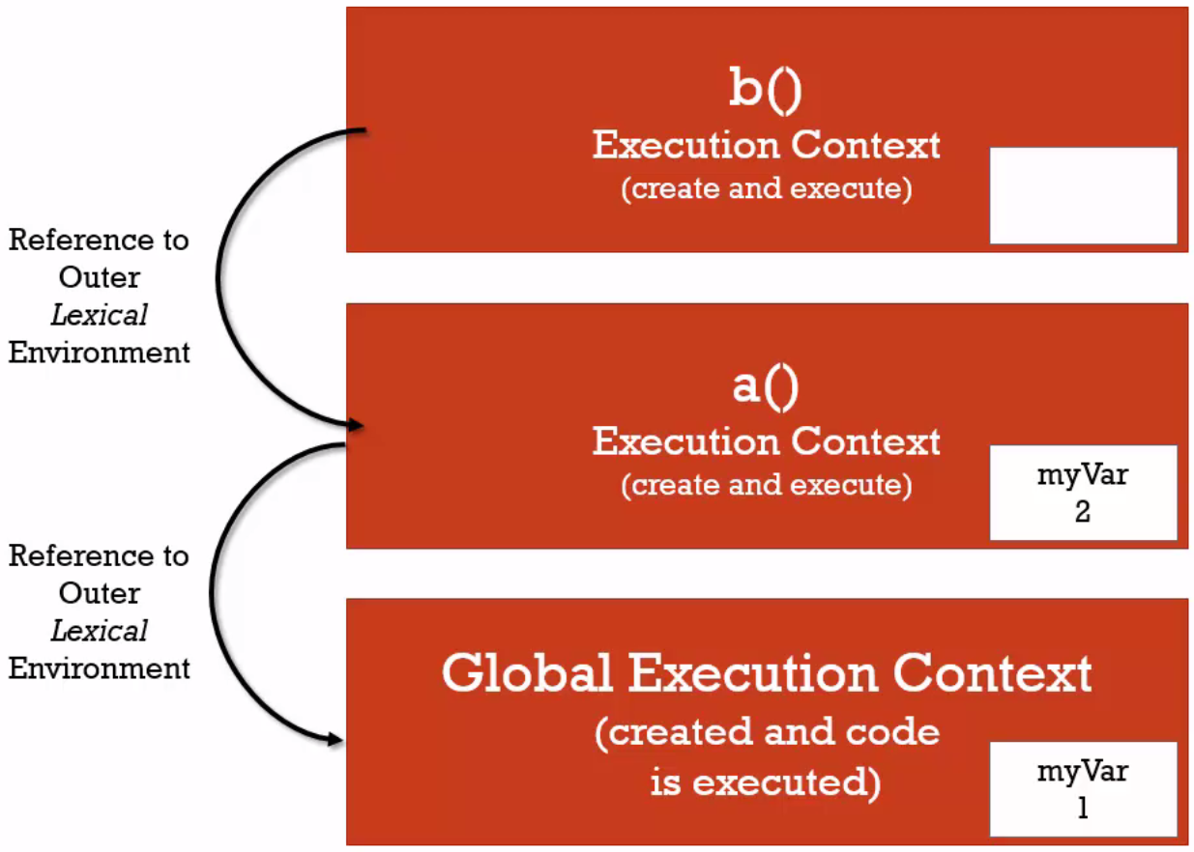
Scope Chain
function a(){
function b(){
console.log(myVar)
}
var myVar = 2;
b();
}
var myVar = 1; a();
Notes:
Section 2: Lecture 14 & 15
* Reference to outer (Lexical) environment

Slide 30
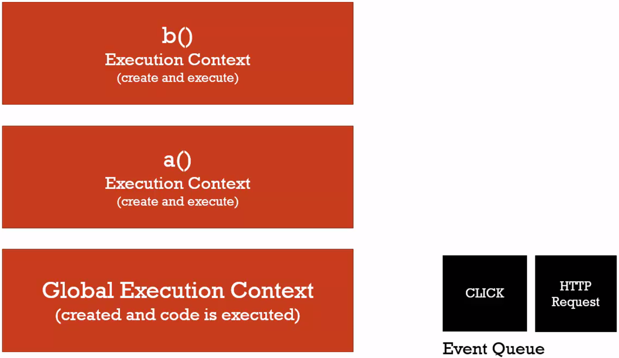
Asynchronous Callbacks
Notes:
Section 2: Lecture 18
TODO: Demo sample code from lecture
Questions for Execution Context?

Slide 31
Data Types

Slide 32
6 Primitive Types
Undefined – lack of existence – set by JavaScript Engine
Null – lack of existence – nothing
Boolean – True or False
Number – Float or Int
String – sequence of characters
Symbol – ES6 (ECMA Script 6)
Notes:
6 Primitive Types - not an object
Undefined – lack of existence – set by JavaScript Engine
Null – lack of existence – nothing
Boolean – True or False
Number – Floating or Int
String – sequence of characters
Symbol – ES6 (ECMA Script 6)

Slide 33
Data Types
JavaScript uses Dynamic Typing
same variable can be used as different types
var x; // x is undefined x = 5; // Now x is a Number x = "John"; // Now x is a String x = 'John'; // x is still a String

Slide 34
Operator Precedence and Associativity
Operator Precedence
Which operator functions will be called first
Highest precedence first
Associativity
What order operator functions of the same precedence to be called in
Left to Right or
Right to Left
Notes:
https://developer.mozilla.org/en/docs/Web/JavaScript/Reference/Operators/Operator_Precedence
Operator-Precedence-In-Javascript.pdf

Slide 35
Coercion
Converting a value from one type to another
var a | console.log(a)
1 + 2 | 3
‘hello ’ + ‘world’ | ‘hello world’
1 + ‘2’ | 12
‘5’ – 2 | 3
16 + 4 + "Ideyatech"; | ’20Ideyatech’
Notes:
JS uses coercion since it is Dynamic Type

Slide 36
Comparison Operators
1 < 2 < 3 returns true
3 < 2 < 1 returns true why?
Notes:
3 < 2 = false
false < 1 = Number(false) < 1 = 0 < 1 = true
1 < 2 = true
True < 3 = 1 < 3 = true
Number(undefined) = NaN
Number(null) = 0
Number(“3”)
Equality coerce values then compare
False == 0 is TRUE
Null == 0 false
null < 1 true
“” == 0 true
“” == false TRUE
Strict Equality === compares two values and does not coerce values
https://developer.mozilla.org/en-US/docs/Web/JavaScript/Equality_comparisons_and_sameness

Slide 37
Existence and Booleans
Boolean(undefined), Boolean(null), Boolean(“”) returns false
Lack of Existence
Boolean(0) returns false
Notes:
Request a value from an API
if (responseValue || responseValue === 0){
//use responseValue
}

Slide 38
Default Values
function greet(name){
//careful with 0
name = name || '<Your name is...>'
console.log('Hi ' + name);
}
Notes:
Undefined || “Hello” returns Hello
Commonly used in frameworks to avoid collision
Another way to avoid collision: Create namespace

Slide 39
JavaScript Objects
Collection of name/value pairs
Primitive
Object
Function = “methods”
Accessing Object Members:
person.firstName
person[“firstName”]

Slide 40
JavaScript Objects
var person = {};
person["firstName"] = "John",
person["lastName"] = "Doe“
var person = {
firstName: "John",
lastName: "Doe",
age: 50,
eyeColor: "blue"
};
Notes:
Object Literal:
var person = new Object();
var person = {};
Faking Namespaces:
Container
Common mistake:
person.address.street
Associativity: undefined.street
Cannot set property street of undefined

Slide 41
JSON
JSON stands for JavaScript Object Notation
JSON is lightweight data interchange format
JSON is language independent *
JSON is "self-describing" and easy to understand
Notes:
JSON is stricter
JSON and Object Literals
JS Object Notation
Properties must be enclosed in quotes
JSON.stringify
JSON.parse

Slide 42
JSON vs Object Literal
JSON is stricter
Properties must be enclosed in quotes
All JSON are valid JS Objects
Not all Objects are valid JSON
JS methods to convert JSON
JSON.stringify
JSON.parse
Notes:
JSON is stricter
JSON and Object Literals
JS Object Notation
Properties must be enclosed in quotes
JSON.stringify
JSON.parse

Slide 43
Functions
Functions are Objects
First Class Functions
What you can do with variables, you can do with functions
Pass to parameters
Create functions on the fly
Special type of object
Name (Anonymous)
Code ( Invocable () )
Notes:
function greet(){
console.log("Hi");
}
greet.language = "english“

Slide 44
Function Statement and Function Expressions
Expression
Unit of code that results in a value
Statement
Runs a code without returning a value

Slide 45
Function Statement and Function Expressions
greet()
function greet(){
console.log("Hi");
}
greet2()
var greet2 = function(){
console.log("Hi");
}

Slide 46
By Value and By Reference
if primitive, copies value
if object, copy memory location
Notes:
By Value vs By Reference
if primitive copies value
if object points to same location
// by value (primitives)
var a = 3;
var b;
b = a;
a = 2;
console.log(a);
console.log(b);
// by reference (all objects (including functions))
var c = { greeting: 'hi' };
var d;
d = c;
c.greeting = 'hello'; // mutate
console.log(c);
console.log(d);
// by reference (even as parameters)
function changeGreeting(obj) {
obj.greeting = 'Hola'; // mutate
}
changeGreeting(d);
console.log(c);
console.log(d);
// equals operator sets up new memory space (new address)
c = { greeting: 'howdy' };
console.log(c);
console.log(d);

Slide 47
this
Refers to the object that wraps the execution context

Slide 48
Arrays
Collection of anything
var arr = [
1,
false,
{
name: 'Mars',
address: 'Makati'
},
function(){
console.log("Hello");
},
"Hi"
];

Slide 49
Arguments and Spread
Arguments
Parameters passed to a function
arguments – keyword that contains all parameters
Spread
Wraps up parameters
Will replace arguments
function greet(firstname, lastname, language, ...other)
Notes:
*method overloading does not apply to JS
function greet(firstname, lastname, language) {
language = language || 'en';
if (arguments.length === 0) {
console.log('Missing parameters!');
console.log('-------------');
return;
}
console.log(firstname);
console.log(lastname);
console.log(language);
console.log(arguments);
console.log('arg 0: ' + arguments[0]);
console.log('-------------');
}
greet();
greet('John');
greet('John', 'Doe');
greet('John', 'Doe', 'es');
// in ES6 I can do: function greet(firstname, ...other)
// and 'other' will be an array that contains the rest of the arguments

Slide 50
IIFE
// using an Immediately Invoked Function Expression (IIFE)
var greeting = function(name) {
return 'Hello ' + name;
}('John');
console.log(greeting);
// IIFE
var firstname = 'John';
(function(name) {
var greeting = 'Inside IIFE: Hello';
console.log(greeting + ' ' + name);
}(firstname)); // IIFE
Notes:
// function statement
function greet(name) {
console.log('Hello ' + name);
}
greet('John');
// using a function expression
var greetFunc = function(name) {
console.log('Hello ' + name);
};
greetFunc('John');
// using an Immediately Invoked Function Expression (IIFE)
var greeting = function(name) {
return 'Hello ' + name;
}('John');
console.log(greeting);
// IIFE
var firstname = 'John';
(function(name) {
var greeting = 'Inside IIFE: Hello';
console.log(greeting + ' ' + name);
}(firstname)); // IIFE

Slide 51
IIFE
Runs the code upon creation
Creates new execution context
Used by frameworks to avoid collision
Notes:
// function statement
function greet(name) {
console.log('Hello ' + name);
}
greet('John');
// using a function expression
var greetFunc = function(name) {
console.log('Hello ' + name);
};
greetFunc('John');
// using an Immediately Invoked Function Expression (IIFE)
var greeting = function(name) {
return 'Hello ' + name;
}('John');
console.log(greeting);
// IIFE
var firstname = 'John';
(function(name) {
var greeting = 'Inside IIFE: Hello';
console.log(greeting + ' ' + name);
}(firstname)); // IIFE

Slide 52
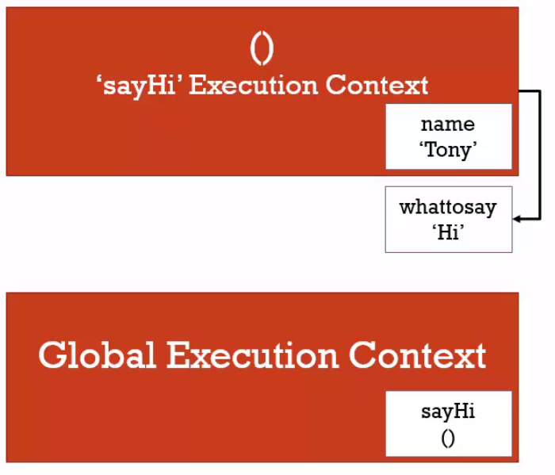
Closures
JS makes sure that the function still have access to the variables that it should have access to.
Notes:
*callbacks -
function greet(whattosay) {
return function(name) {
console.log(whattosay + ' ' + name);
}
}
var sayHi = greet('Hi');
sayHi('Tony');
function buildFunctions() {
var arr = [];
for (var i = 0; i < 3; i++) {
arr.push(
function() {
console.log(i);
}
)
}
return arr;
}
var fs = buildFunctions();
fs[0]();
fs[1]();
fs[2]();
function buildFunctions2() {
var arr = [];
for (var i = 0; i < 3; i++) {
arr.push(
(function(j) {
return function() {
console.log(j);
}
}(i))
)
}
return arr;
}
var fs2 = buildFunctions2();
fs2[0]();
fs2[1]();
fs2[2]();

Slide 53
Call, Apply and Bind
call - Executes the function and defines ‘this’
bind – creates a copy of the function and defines ‘this’
apply – same as call but parameters are enclosed in []
Function Borrowing
Function Currying – copying a function and setting preset parameters
Notes:
var person = {
firstname: 'John',
lastname: 'Doe',
getFullName: function() {
var fullname = this.firstname + ' ' + this.lastname;
return fullname;
}
}
var logName = function(lang1, lang2) {
console.log('Logged: ' + this.getFullName());
console.log('Arguments: ' + lang1 + ' ' + lang2);
console.log('-----------');
}
var logPersonName = logName.bind(person);
logPersonName('en');
logName.call(person, 'en', 'es');
logName.apply(person, ['en', 'es']);
(function(lang1, lang2) {
console.log('Logged: ' + this.getFullName());
console.log('Arguments: ' + lang1 + ' ' + lang2);
console.log('-----------');
}).apply(person, ['es', 'en']);
// function borrowing
var person2 = {
firstname: 'Jane',
lastname: 'Doe'
}
console.log(person.getFullName.apply(person2));
// function currying
function multiply(a, b) {
return a*b;
}
var multipleByTwo = multiply.bind(this, 2);
console.log(multipleByTwo(4));
var multipleByThree = multiply.bind(this, 3);
console.log(multipleByThree(4));

Slide 54
Object-Oriented JS and Prototypal Inheritance

Slide 55
Classical vs Prototypal Inheritance
Inheritance
object gets access to the properties and methods of another object
Classical - verbose
Prototypal - simple

Slide 56
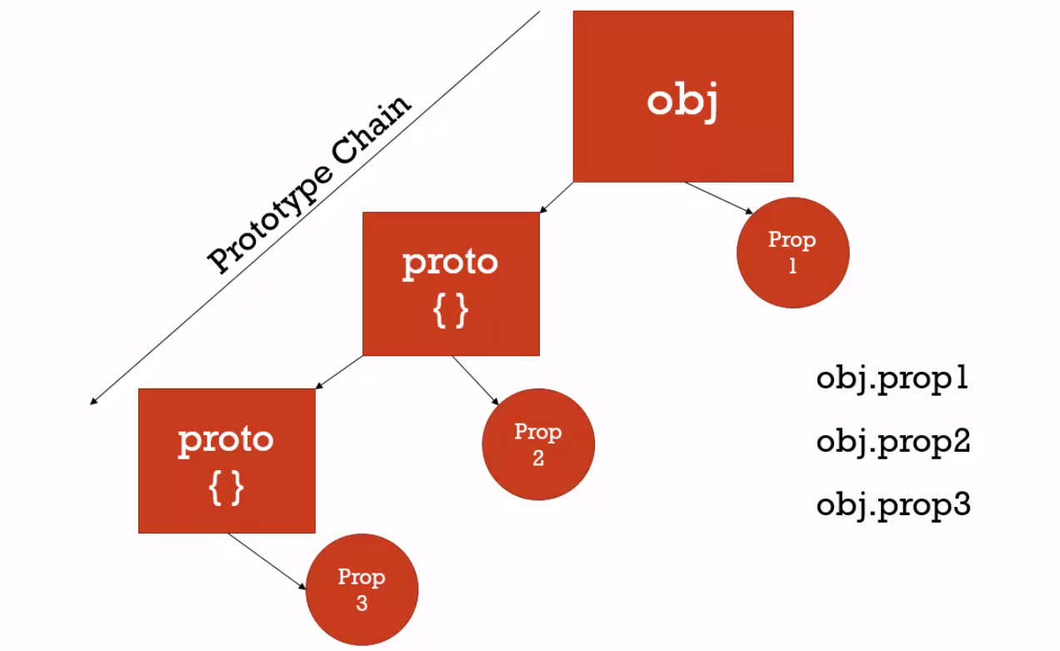
Understanding the Prototype
Prototype Chain
similar to scope chain
Notes:
TODO: draw prototype chain

Slide 57
Reflection
Reflection – an object can look at itself listing and changing its properties and methods
FOR/IN – list all properties of an object

Slide 58
Building Objects
Object Literal
var mars = new Person();
new – set the ‘this’ keyword to a brand new object and returns the properties/methods attached to it
Notes:
function Person(firstname, lastname) {
console.log(this);
this.firstname = firstname;
this.lastname = lastname;
console.log('This function is invoked.');
}
var john = new Person('John', 'Doe');
console.log(john);
var jane = new Person('Jane', 'Doe');
console.log(jane);

Slide 59
Function Constructors
Function Constructor – a function used to create an object
<functionName>.prototype.<property/method>
Notes:
function Person(firstname, lastname) {
console.log(this);
this.firstname = firstname;
this.lastname = lastname;
console.log('This function is invoked.');
}
Person.prototype.getFullName = function() {
return this.firstname + ' ' + this.lastname;
}
var john = new Person('John', 'Doe');
console.log(john);
var jane = new Person('Jane', 'Doe');
console.log(jane);
Person.prototype.getFormalFullName = function() {
return this.lastname + ', ' + this.firstname;
}
console.log(john.getFormalFullName());

Slide 60
Built-in Function Constructors
String()
Number()
Creates an object that contains a primitive values
Notes:
Primitive vs String() or Number()

Slide 61
Pure Prototypal Inheritance
var person = {
firstname: 'Default',
lastname: 'Default',
greet: function() {
return 'Hi ' + this.firstname;
}
}
var john = Object.create(person);
john.firstname = 'John';
john.lastname = 'Doe';
console.log(john);
Notes:
// polyfill – code that adds a feature which the engine may lack
if (!Object.create) {
Object.create = function (o) {
if (arguments.length > 1) {
throw new Error('Object.create implementation'
+ ' only accepts the first parameter.');
}
function F() {}
F.prototype = o;
return new F();
};
}
var person = {
firstname: 'Default',
lastname: 'Default',
greet: function() {
return 'Hi ' + this.firstname;
}
}
var john = Object.create(person);
john.firstname = 'John';
john.lastname = 'Doe';
console.log(john);

Slide 62
Pure Prototypal Inheritance
// polyfill – code that adds a feature which the engine may lack
if (!Object.create) {
Object.create = function (o) {
if (arguments.length > 1) {
throw new Error('Object.create implementation'
+ ' only accepts the first parameter.');
}
function F() {}
F.prototype = o;
return new F();
};
}
Notes:
// polyfill – code that adds a feature which the engine may lack
if (!Object.create) {
Object.create = function (o) {
if (arguments.length > 1) {
throw new Error('Object.create implementation'
+ ' only accepts the first parameter.');
}
function F() {}
F.prototype = o;
return new F();
};
}
var person = {
firstname: 'Default',
lastname: 'Default',
greet: function() {
return 'Hi ' + this.firstname;
}
}
var john = Object.create(person);
john.firstname = 'John';
john.lastname = 'Doe';
console.log(john);

Slide 63
Learn From Other’s Good Code

Slide 64
Asynchronous JavaScript and XML

Slide 65
AJAX
Asynchronous JavaScript and XML

Slide 66
AJAX
AJAX is not a new programming language, but a new way to use existing standards.
AJAX is the art of exchanging data with a server, and updating parts of a web page - without reloading the whole page.

Slide 67
<script>
function loadXMLDoc()
{
var xmlhttp;
if (window.XMLHttpRequest)
{// code for IE7+, Firefox, Chrome, Opera, Safari
xmlhttp=new XMLHttpRequest();
}
else
{// code for IE6, IE5
xmlhttp=new ActiveXObject("Microsoft.XMLHTTP");
}
xmlhttp.onreadystatechange=function()
{
if (xmlhttp.readyState==4 && xmlhttp.status==200)
{
document.getElementById("myDiv").innerHTML=xmlhttp.responseText;
}
}
xmlhttp.open("GET","data.txt",true);
xmlhttp.send();
}
</script>

